Slide 1
The Technology Value Stream
Exploring Lead Times, Processing Times, and DevOps Ideals
Puna Poudel

Slide 2
What is the Technology Value Stream?
The technology value stream represents the sequence of activities required to convert a customer need into a deliverable product or service, focusing on optimizing efficiency and reducing waste.
Purpose:
To deliver value to the customer while minimizing delays, bottlenecks, and inefficiencies.

Slide 3
Lead Time vs. Processing Time
Lead Time: The total time from the initiation of a request to the fulfillment of that request, including both active work and waiting time.
Processing Time: The actual time spent actively working on a task or activity within the lead time.
Key Insight: Long lead times often result from delays and inefficiencies, not extended processing times.

Slide 4
Common Scenario: Deployment Lead Times Requiring Months
Historically, deployment lead times spanned weeks or months due to silos, manual processes, and a lack of automation.
Impact:
- Slow delivery of customer value.
- Increased risk of errors and rework.
- Reduced competitiveness in the market.

Slide 5
Our DevOps Ideal: Deployment Lead Times of Minutes
The DevOps philosophy emphasizes reducing deployment lead times to minutes through automation, collaboration, and continuous delivery practices.
Strategies to Achieve This Ideal:
- Implementing continuous integration/continuous delivery (CI/CD).
- Adopting infrastructure as code (IaC).
- Enhancing communication and removing silos.
Benefits:
- Faster delivery of features and fixes.
- Improved customer satisfaction.
- Enhanced system reliability through smaller, incremental changes.

Slide 6
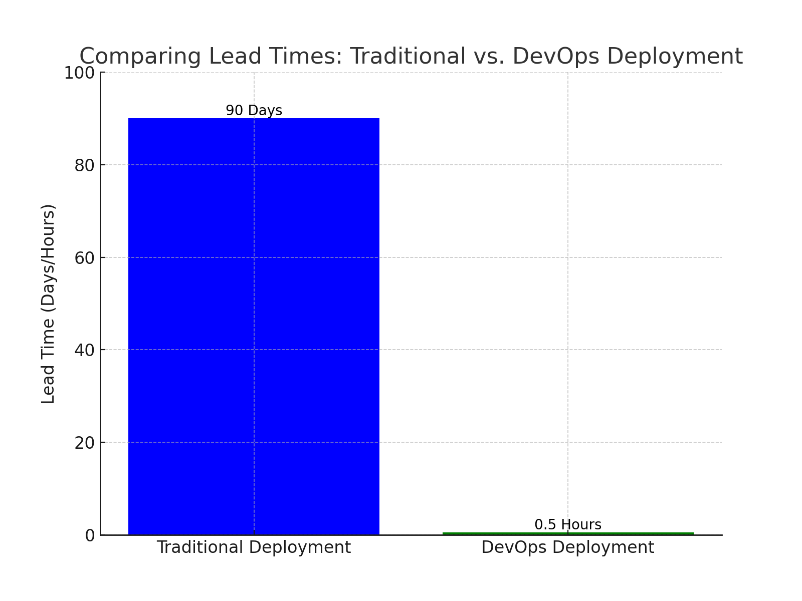
Graphic comparing traditional vs. DevOps lead times.

Slide 7
Real-World Examples
Netflix: Uses automation and CI/CD pipelines to deploy hundreds of changes daily.
Amazon: Reduced deployment lead times from months to minutes, deploying every 11.7 seconds on average.
Key Takeaway: Organizations achieving DevOps ideals are more agile and responsive to customer needs.

Slide 8
Conclusion
Summary:
Lead time and processing time are distinct but interconnected.
Reducing deployment lead times to minutes aligns with the DevOps philosophy of delivering value quickly and efficiently.

Slide 9
References
Kim, G., Humble, J., Debois, P., & Willis, J. (2016). The DevOps Handbook. IT Revolution Press.
Highsmith, J. (2001). The Agile Manifesto. Agile Alliance. Retrieved from https://agilemanifesto.org
Fowler, M., & Foemmel, M. (2006). Continuous integration. ThoughtWorks. Retrieved from https://martinfowler.com/articles/continuousIntegration.html

